Slide 1

WIRELESS COMMUNICATIONS • ASSIGNMENT 3
Hata-Okumura &
Two-Ray Models

Slide 2


Introduction to Propagation Models
Propagation models are mathematical tools used to predict signal behavior as it travels from transmitter to receiver. They are crucial for:
•
Estimating coverage area for cellular networks.
•
Determining potential interference between stations.
•
Optimizing antenna placement and height.
This assignment analyzes two distinct models:

Slide 3


Hata-Okumura Model: Theory
Overview
Mathematical Formulation
An empirical model widely used for predicting path loss in cellular transmissions in urban and suburban areas. It is valid for frequencies from 150 MHz to 1500 MHz.
Where constants A and B are derived from:
Key Parameters
•
fc: Frequency (MHz)
•
hb, hm: Base station & mobile heights (m)
•
d: Distance (km)

Slide 4
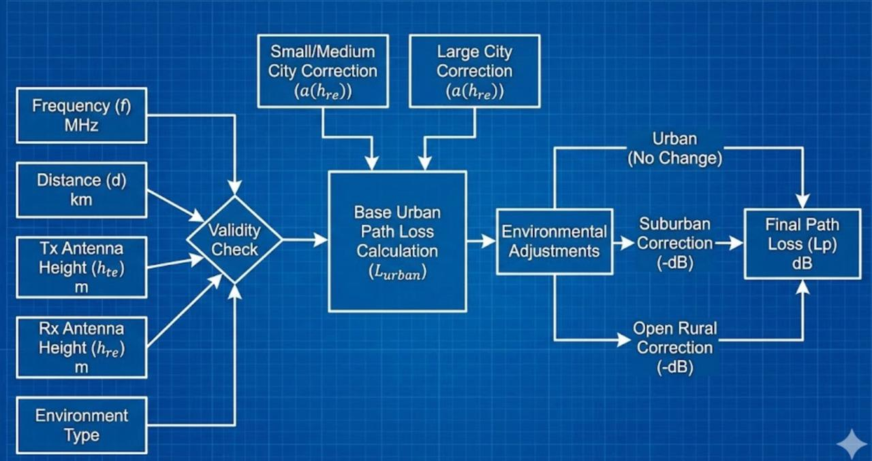
Hata Model: Data Flow Diagram
Process Logic
1.
Input Stage: Accept system parameters (Frequency, Heights) and environment type.
2.
Correction Factor: Calculate a_hm based on the environment (Urban/Suburban) and frequency.
3.
Computation: Compute base loss factors A and B.
4.
Aggregation: Combine factors with distance logarithm to find Path Loss (PL).

Slide 5
Hata Model: Pseudo Code Explanation
Algorithm Steps
FUNCTION hokumara_hata(fc, hm, hb, d, a_hm, C):
A = 69.55 + 26.16 * log10(fc)
- 13.82 * log10(hb)
- a_hm
B = 44.9 - 6.55 * log10(hb)
PL = A + B * log10(d) + C
RETURN PL
END FUNCTION
The code implements a switch-case structure to handle different environmental scenarios.
Case 1 (Standard): Uses a generic correction factor suitable for typical urban settings.
Case 2 (Frequency Dependent): Adjusts the correction factor calculation specifically for large cities, differentiating between frequencies above and below 200 MHz.

Slide 6
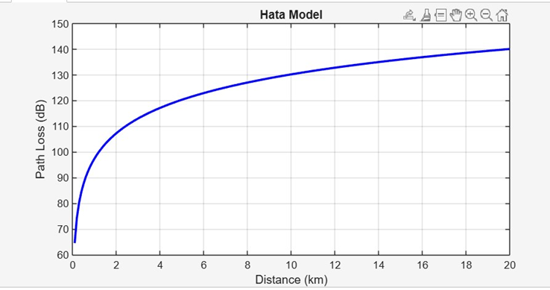
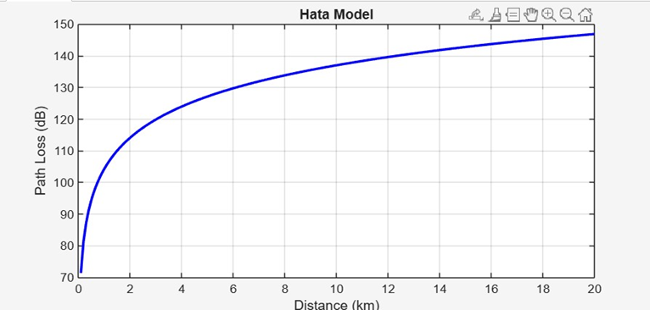

Plot (n=1):
Hata Model Results
The simulation plots Path Loss (dB) against Distance (km).
Observation: As distance increases from 0 to 20 km, the path loss increases logarithmically. This behavior is consistent with the term B * log 10 ( d ) in the equation.
Plot (n=2):
Note: The varying correction factors (a_hm) shift the curve vertically but do not change the logarithmic slope significantly.

Slide 7

Two-Ray Ground Reflection: Theory
Overview
E-Field Calculation
A deterministic model that considers both the direct Line-of-Sight (LOS) path and a single ground reflection path between transmitter and receiver.
It is more accurate than Free Space models for long distances where ground reflections cause signal cancellation.
x = Direct distance
x' = Reflected distance (x_bar)
Γ = Reflection coefficient (-1 for ground)

Slide 8
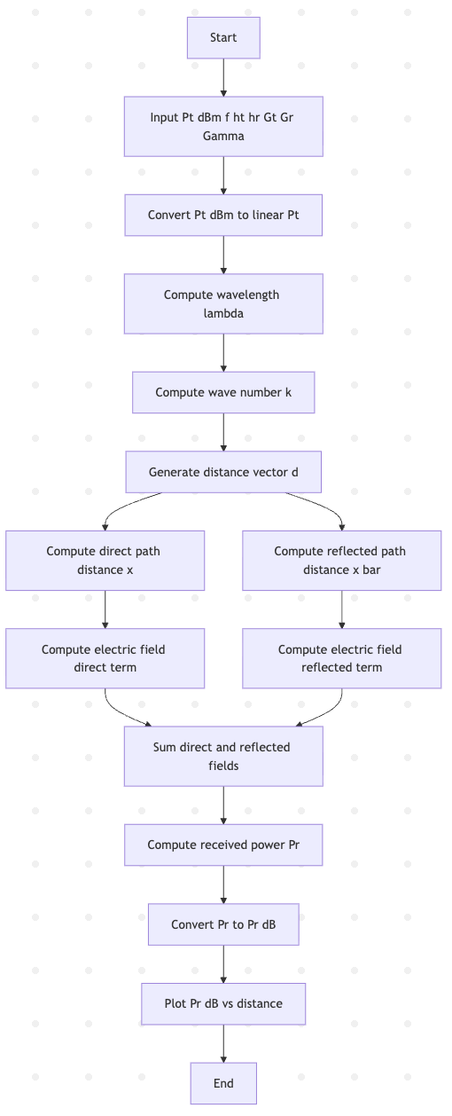
Two-Ray Model: Data Flow Diagram
Process Logic
1.
Geometry Setup: Calculate the hypotenuse for both the direct path (x) and the ground reflection path (x_bar).
2.
Phase Calculation: Compute the phase shift exp ( - j k x ) for both paths based on wavenumber k .
3.
Superposition: Sum the electric fields, accounting for the reflection coefficient Γ = -1 .

Slide 9
Two-Ray Model: Pseudo Code Explanation
Start
Set Pt_dBm = 0
Convert Pt_dBm to linear Pt
Set Gt = 1, Gr = 1
Set f = 900 MHz, ht = 50 m, hr = 2 m
Compute lambda = c/f
Compute k = 2π/lambda
Set Gamma = -1
Set distance range d
Compute x = sqrt(d^2 + (ht - hr)^2)
Compute xR = sqrt(d^2 + (ht + hr)^2)
Compute field:
E = (lambda/4π) * [exp(-j*k*x)/x + Gamma*exp(-j*k*xR)/xR]
Compute power: Pr = Pt*Gt*Gr*|E|²
Convert to dBm: Pr_dB = 10*log10(Pr/1mW)
Plot distance vs Pr_dB on semilog scale
End
Algorithm Steps
1. Power Conversion: Convert Transmit Power from dBm to Watts for linear calculation.
2. Vector Summation: The core of the simulation is summing the complex E-fields. Note the constructive and destructive interference patterns caused by the phase difference between x and x_bar.
3. Output: Convert the received power back to dBm for plotting.

Slide 10
Start
Set carrier frequency fc = 200 MHz
Set base station height hb = 70 m
Set mobile height hm = 1.5 m
Set distance range d from 0.1 km to 20 km
Ask user to input a number n
Switch based on value of n:
Case 1:
Compute a_hm using urban area formula
Compute C for medium-sized city
Call hokumara_hata() to get path loss PL
Case 2:
If fc <= 200:
Compute a_hm for small-to-medium city
Else:
Compute a_hm for larger cities
Set C = 0
Call hokumara_hata() to get PL
End Switch
Plot distance vs. path loss
Label x-axis as distance (km)
Label y-axis as path loss (dB)
Enable grid
End

Slide 11

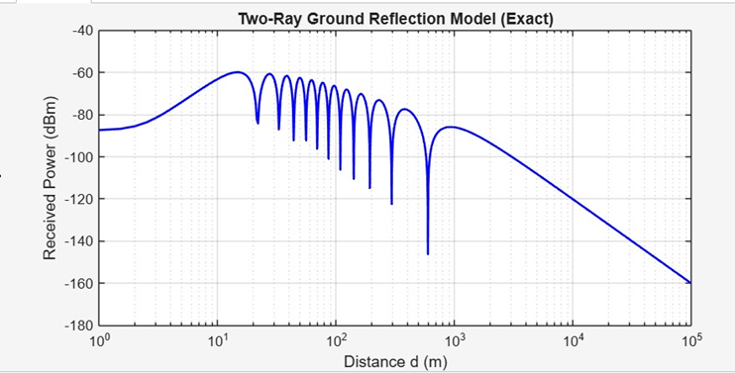
Two-Ray Results
The plot displays Received Power (dBm) vs Distance (m) on a logarithmic scale.
Critical Region
Notice the oscillations at shorter distances (the "break point"). This is due to the rapid phase changing between the direct and reflected rays causing alternating constructive and destructive interference.
Far Field
Beyond the critical distance, the signal decays at a rate of 40 dB/decade (d^{-4}), which is faster than free space (d^{-2}).

